Slide 1
BUAN 6347: ADVANCED BIG DATA ANALYTICS
ASSIGNMENT-2
Aadith Narayan Ravishankar
AXR180085

Slide 2

Part-1
About the code

Slide 3
Deep learning Pipelines are used to build scalable deep learning models in Python with Apache Spark
Extends functionality to SparkMLlib, Keras and Tensorflow
Current code uses Pyspark with a Deep Learning pipeline consisting of ResNet50 and Logistic Regression for Binary Classification of flowers (Daisy or Tulip)
Achieved Testing Accuracy- 96.72%

Slide 4
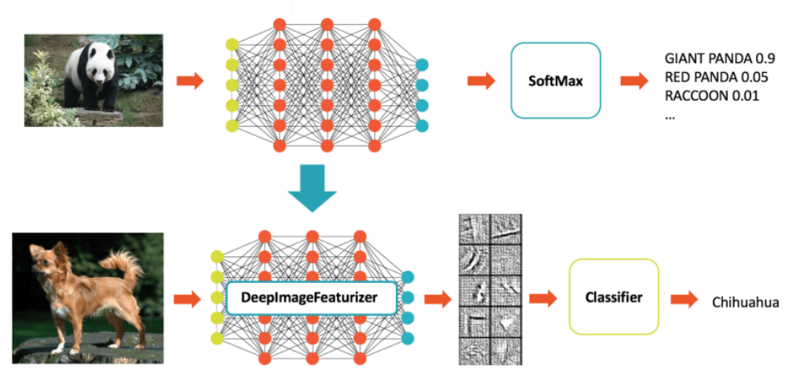
Flow Chart

Slide 5
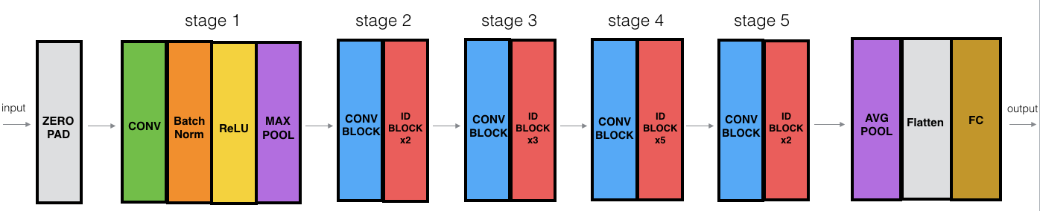
ResNet50

Slide 6
Part 2 and Part 3-The Code Listing along
with Screenshots

Slide 7
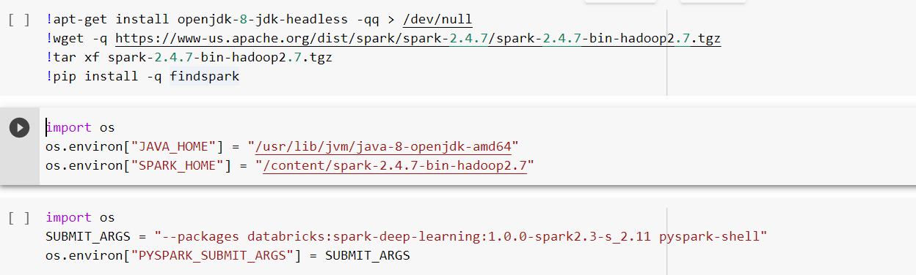
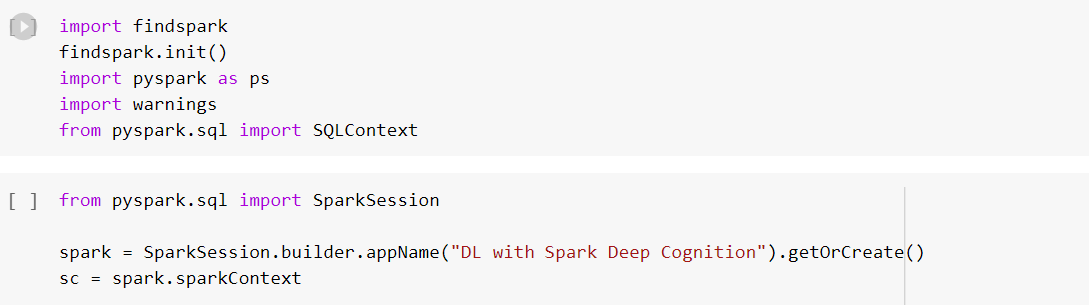
Spark-DL initialization

Slide 8
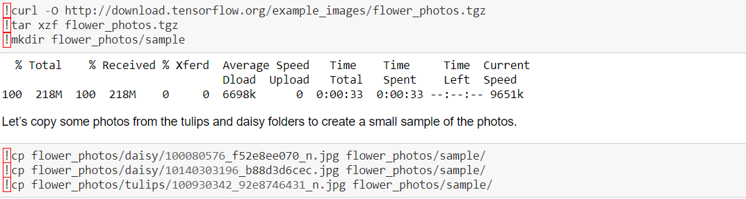
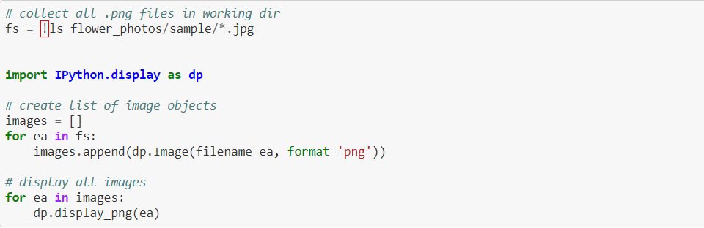
Image Loading

Slide 9




Slide 10
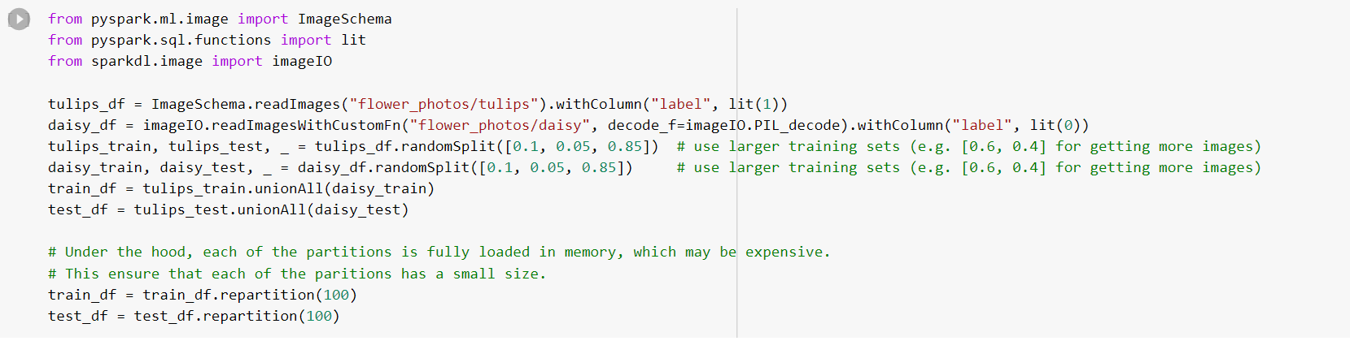
Train and Test datasets

Slide 11
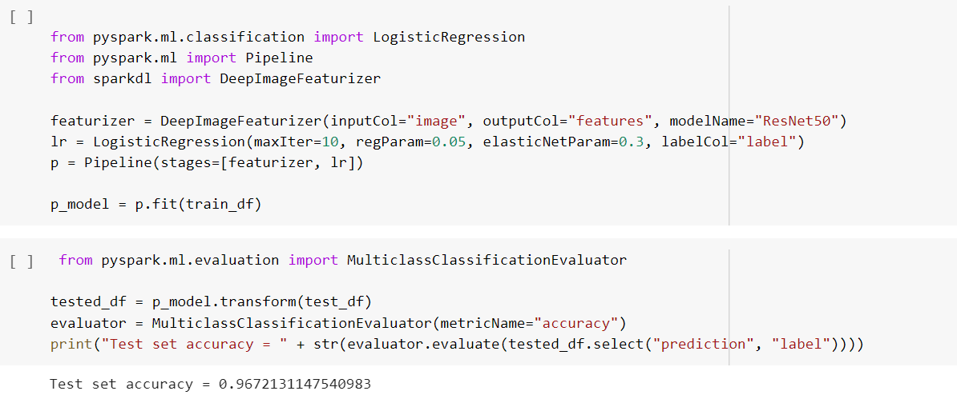
Defining and training the model

Slide 12
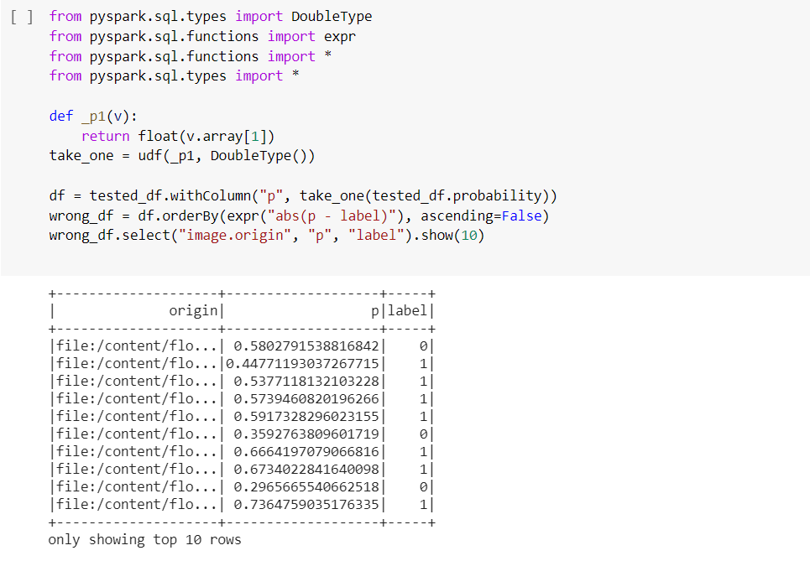
Post prediction Analysis

Slide 13
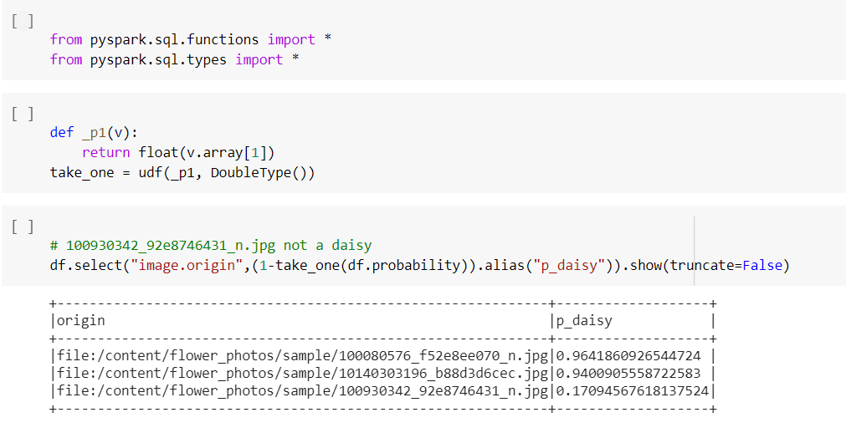

Slide 14
0.17094567
0.96418609
0.940090555

Slide 15

Thank you

